Slide 1

Notes:
Luke 2:41-52

Slide 2
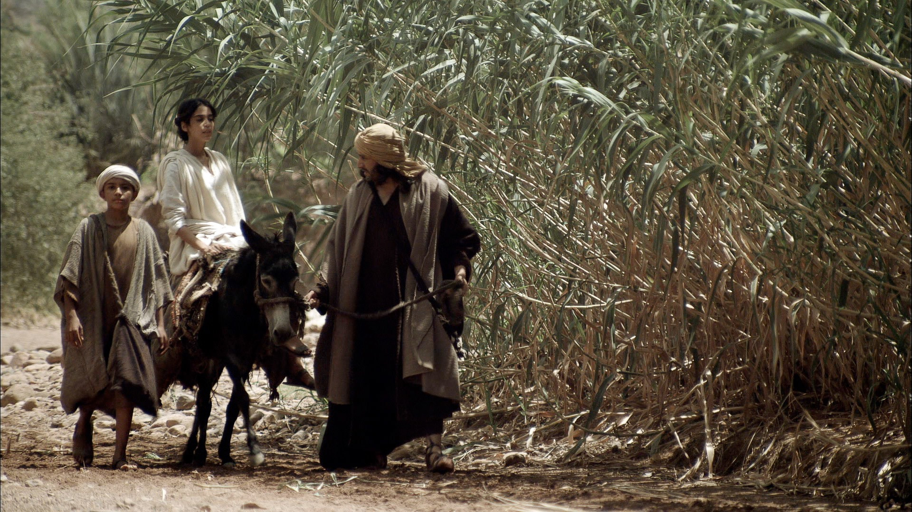
Notes:
When Jesus was twelve years old, Mary and Joseph took Him to Jerusalem for the Festival of the Passover.

Slide 3
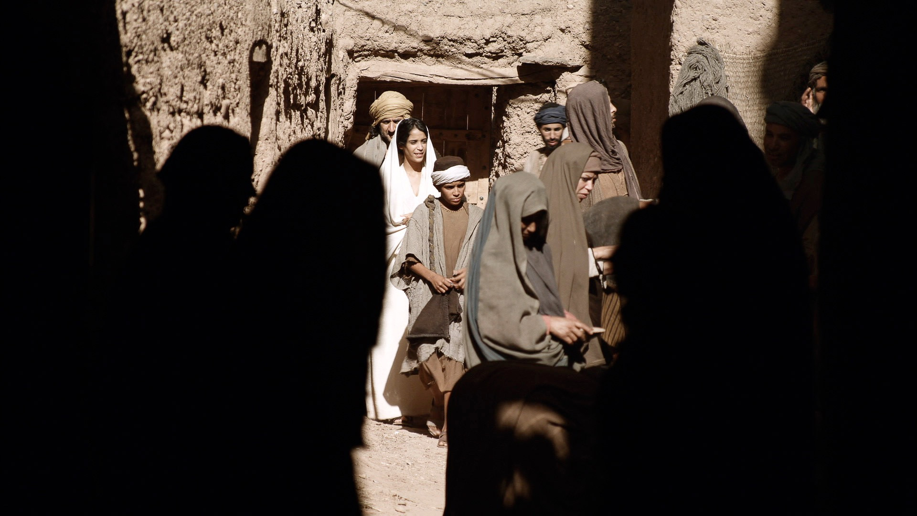
Notes:
It was a holiday celebration they attended every year. Thousands of people from all over the country were in the city and the narrow streets were very crowded.

Slide 4
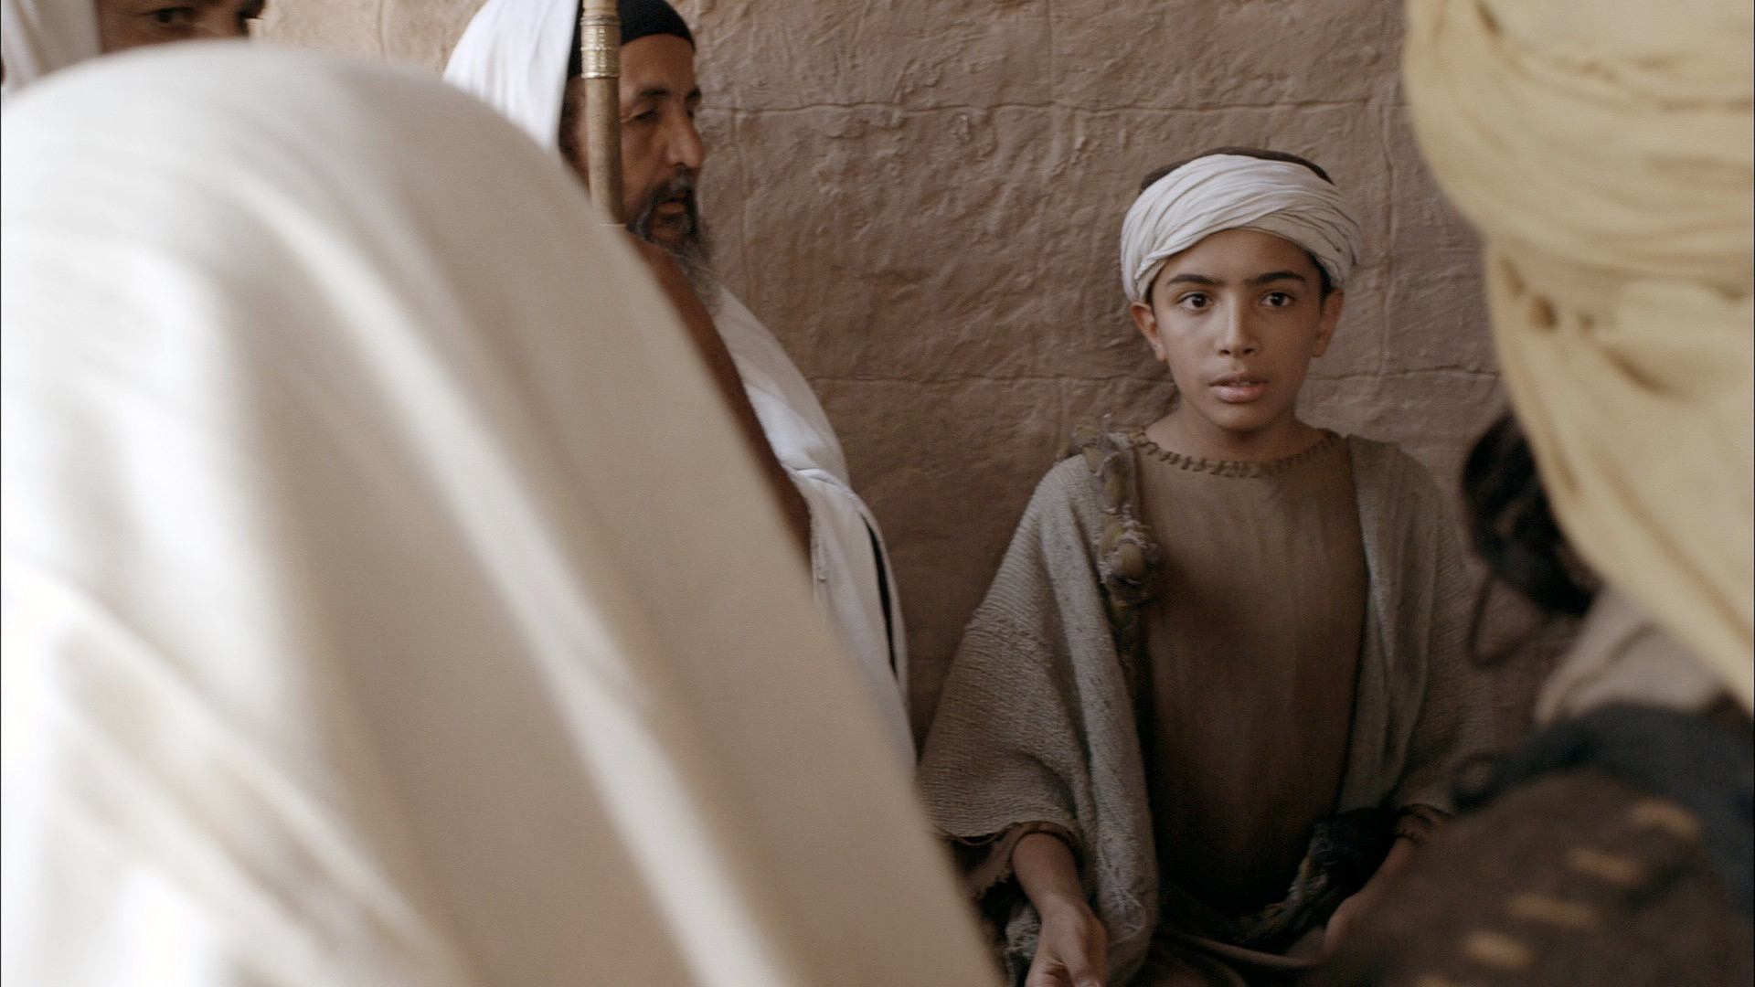
Notes:
At the end of the festival Mary and Joseph joined others from Galilee making the trip home. They thought Jesus was with their relatives and friends in the crowd heading home, but He was in the Temple sitting with the teachers, asking questions and giving answers.

Slide 5
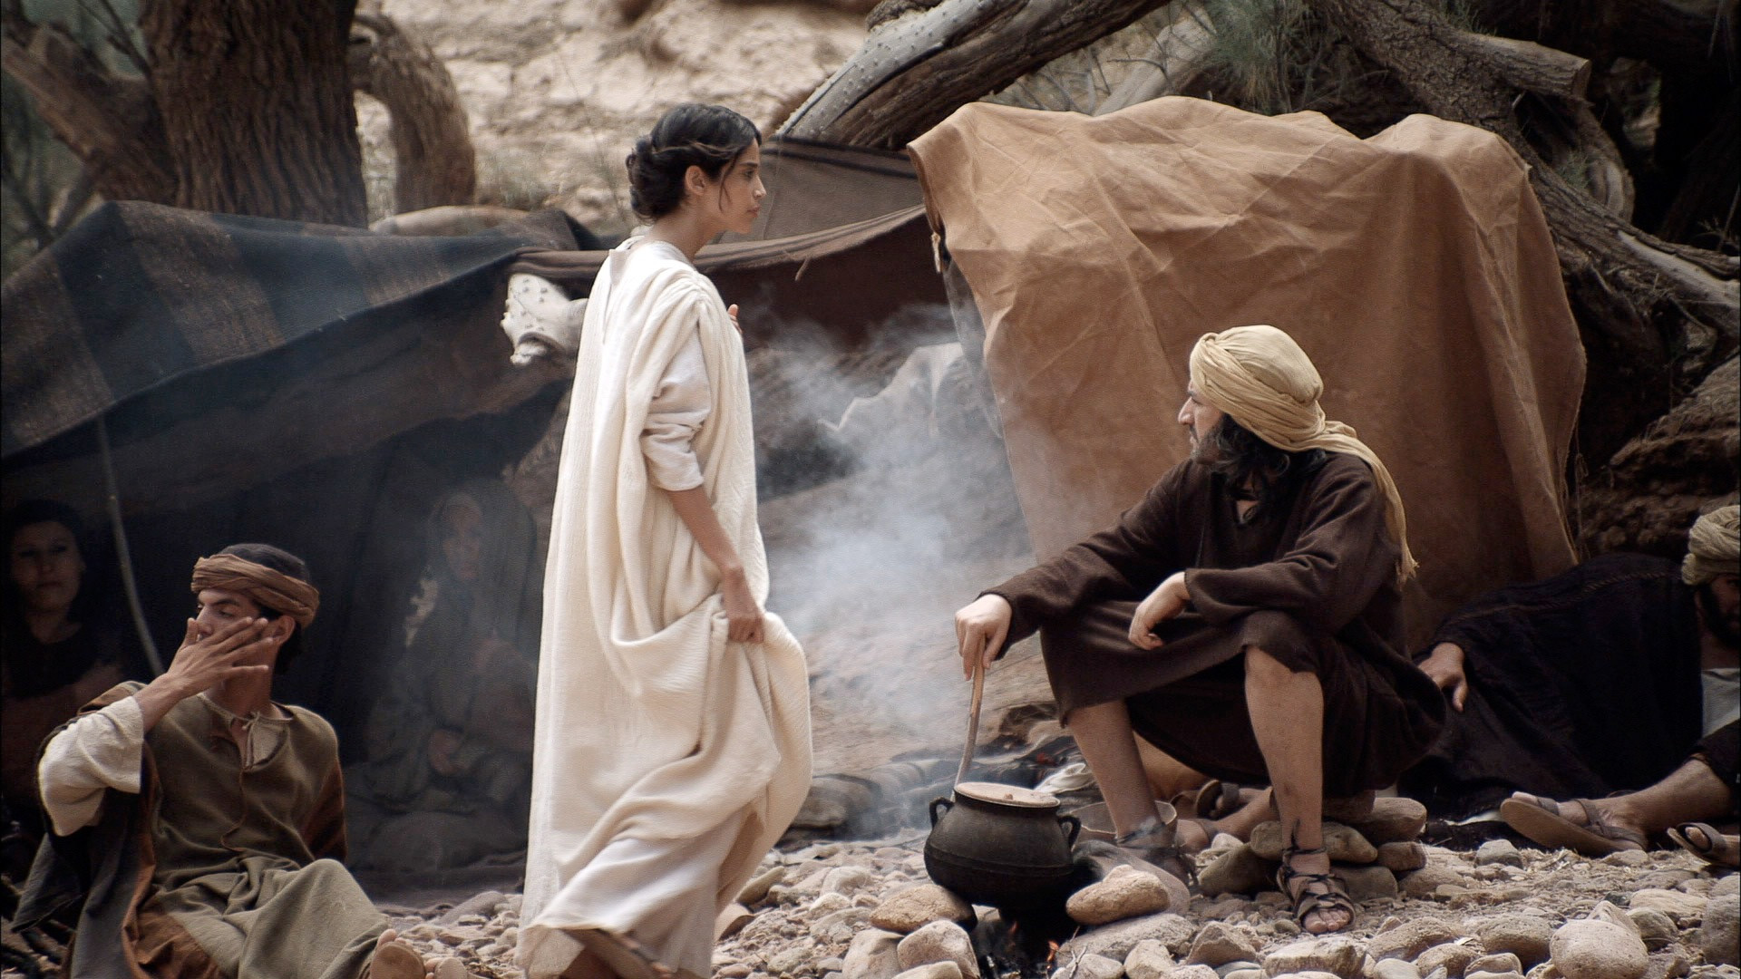
Notes:
That evening Mary and Joseph set up camp and rested.

Slide 6
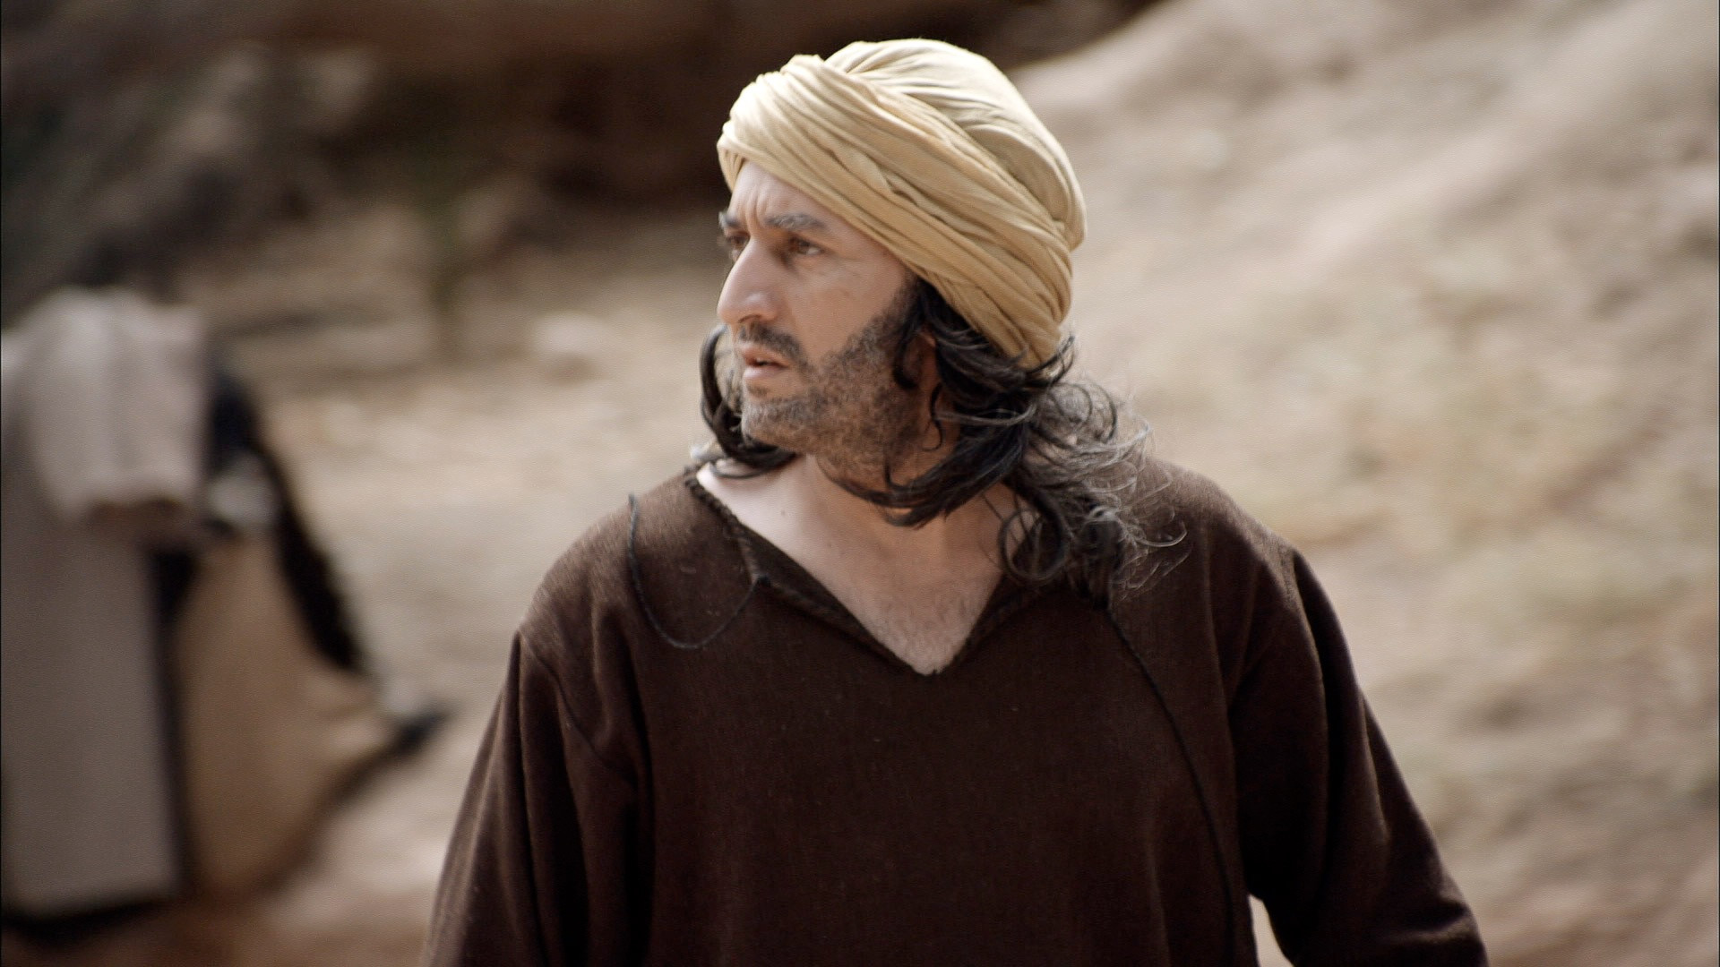
Notes:
But when they looked for Jesus they could not find Him.

Slide 7
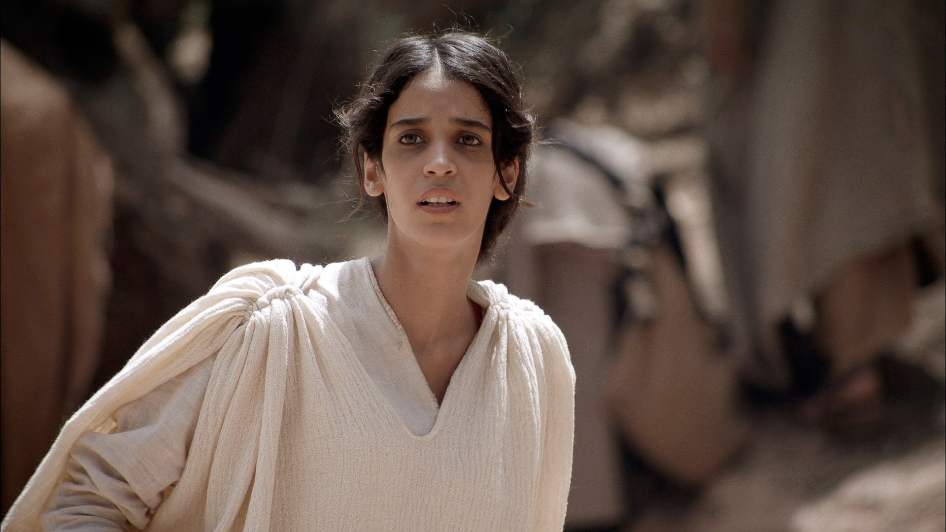
Notes:
After a frantic search they realised Jesus was not with their relatives or friends. Immediately they set off back to Jerusalem to find Him.

Slide 8
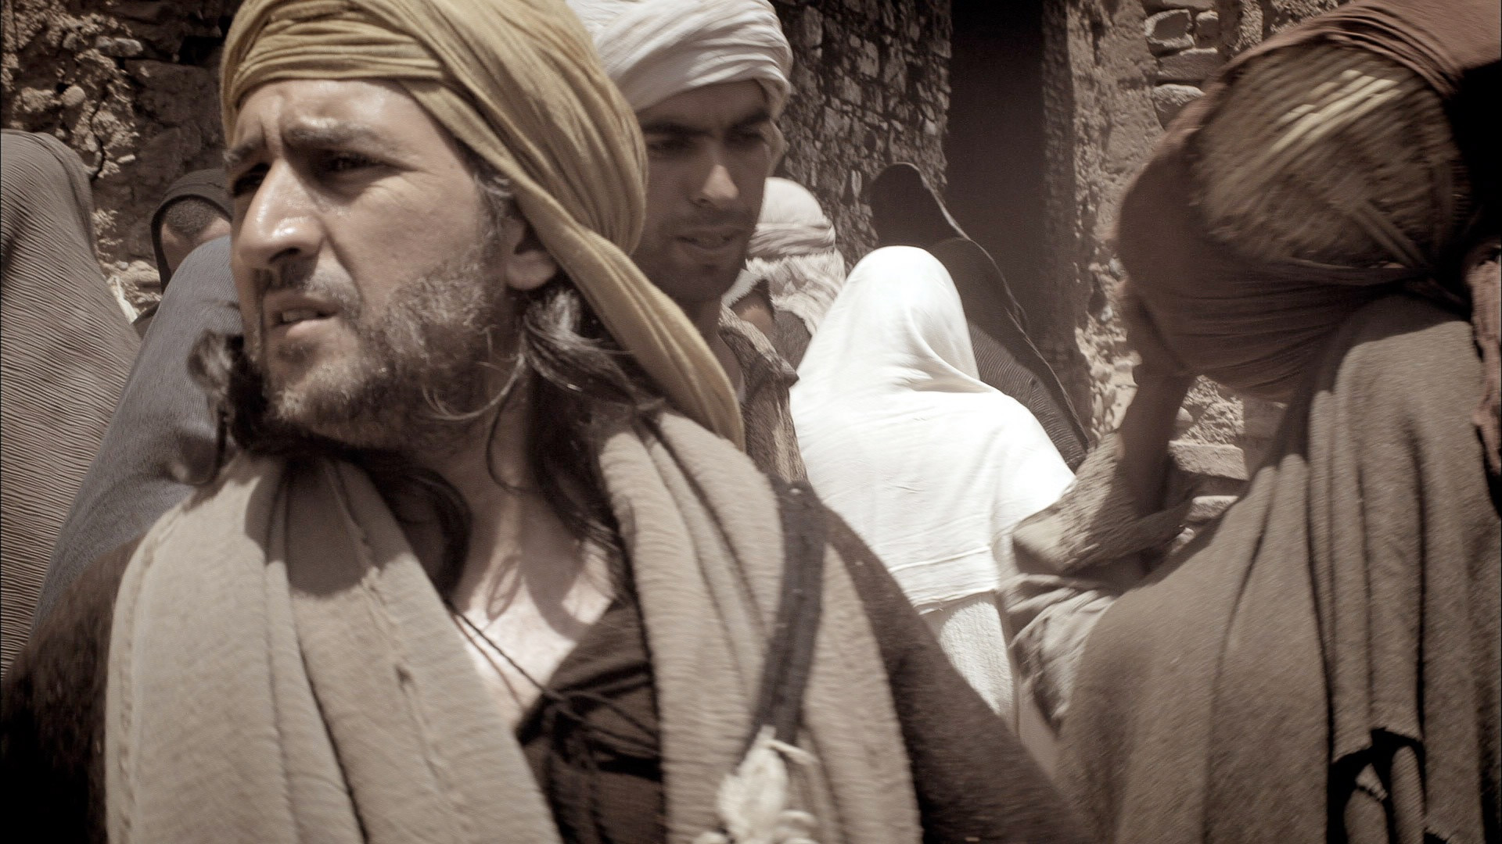
Notes:
They searched the city for three days.

Slide 9
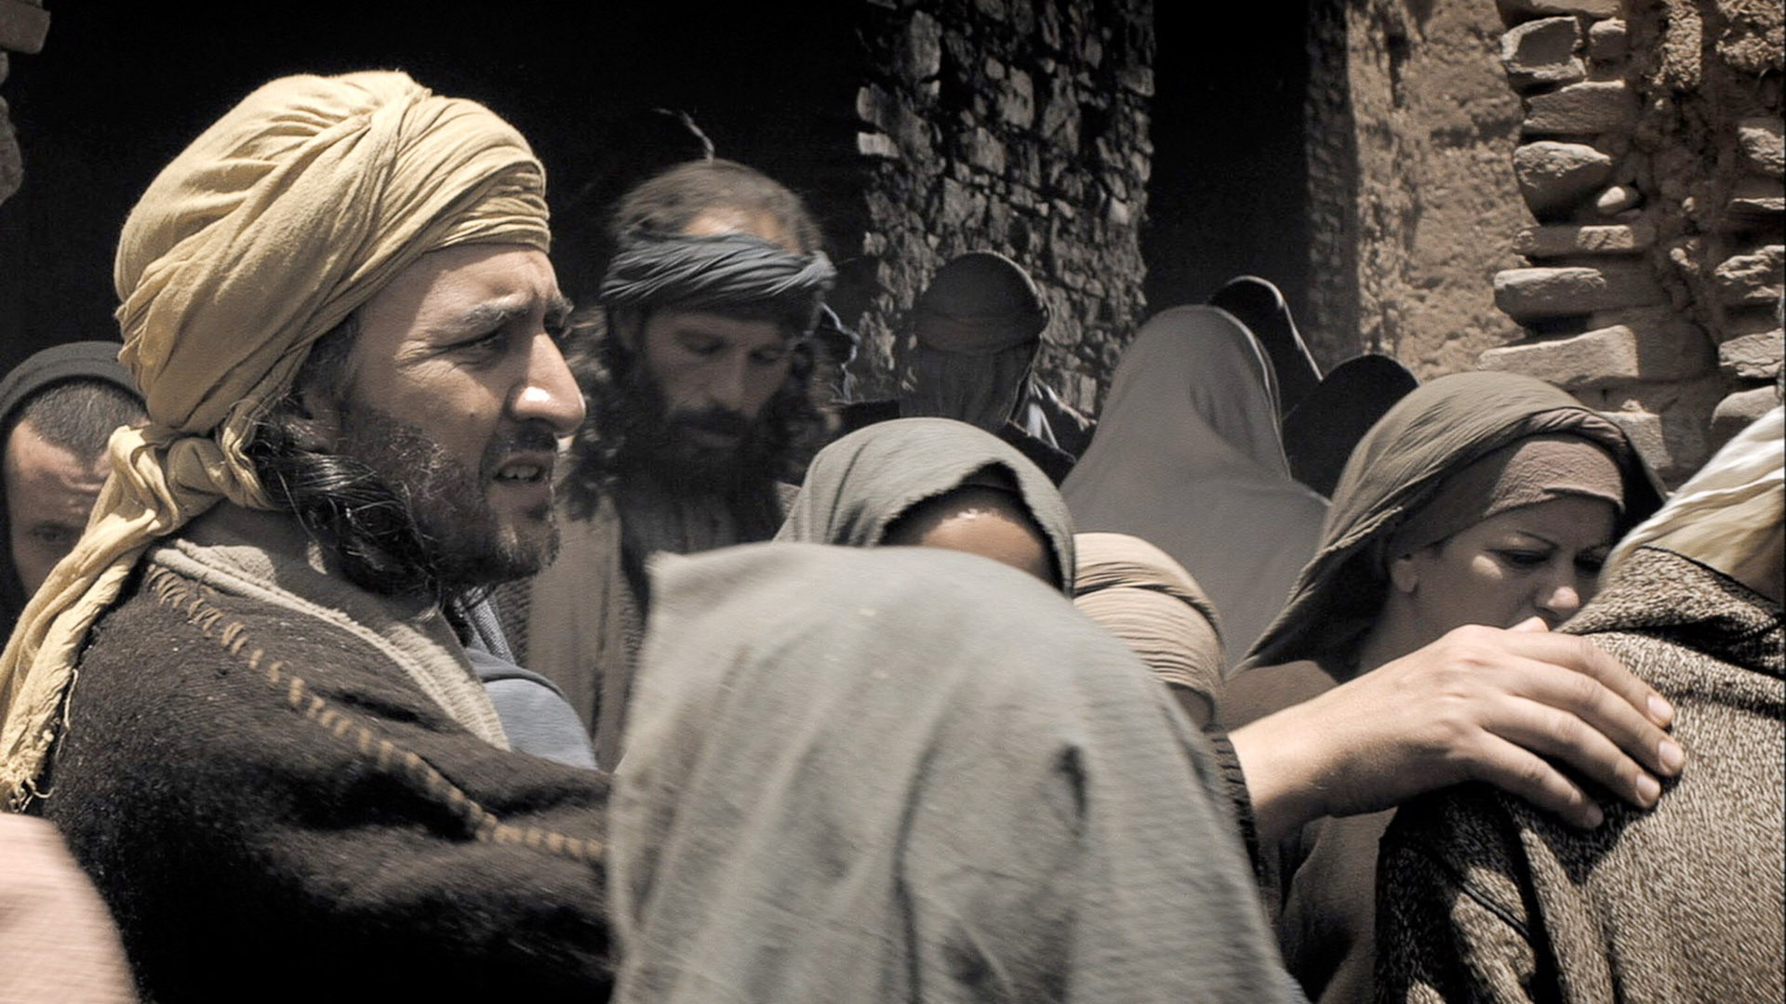
Notes:
But they could not find Jesus.

Slide 10
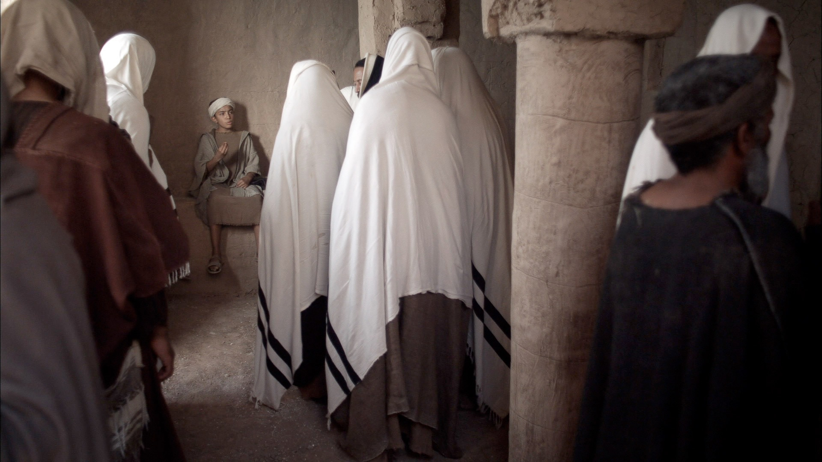
Notes:
Having searched and searched they went into the Temple and suddenly ...

Slide 11
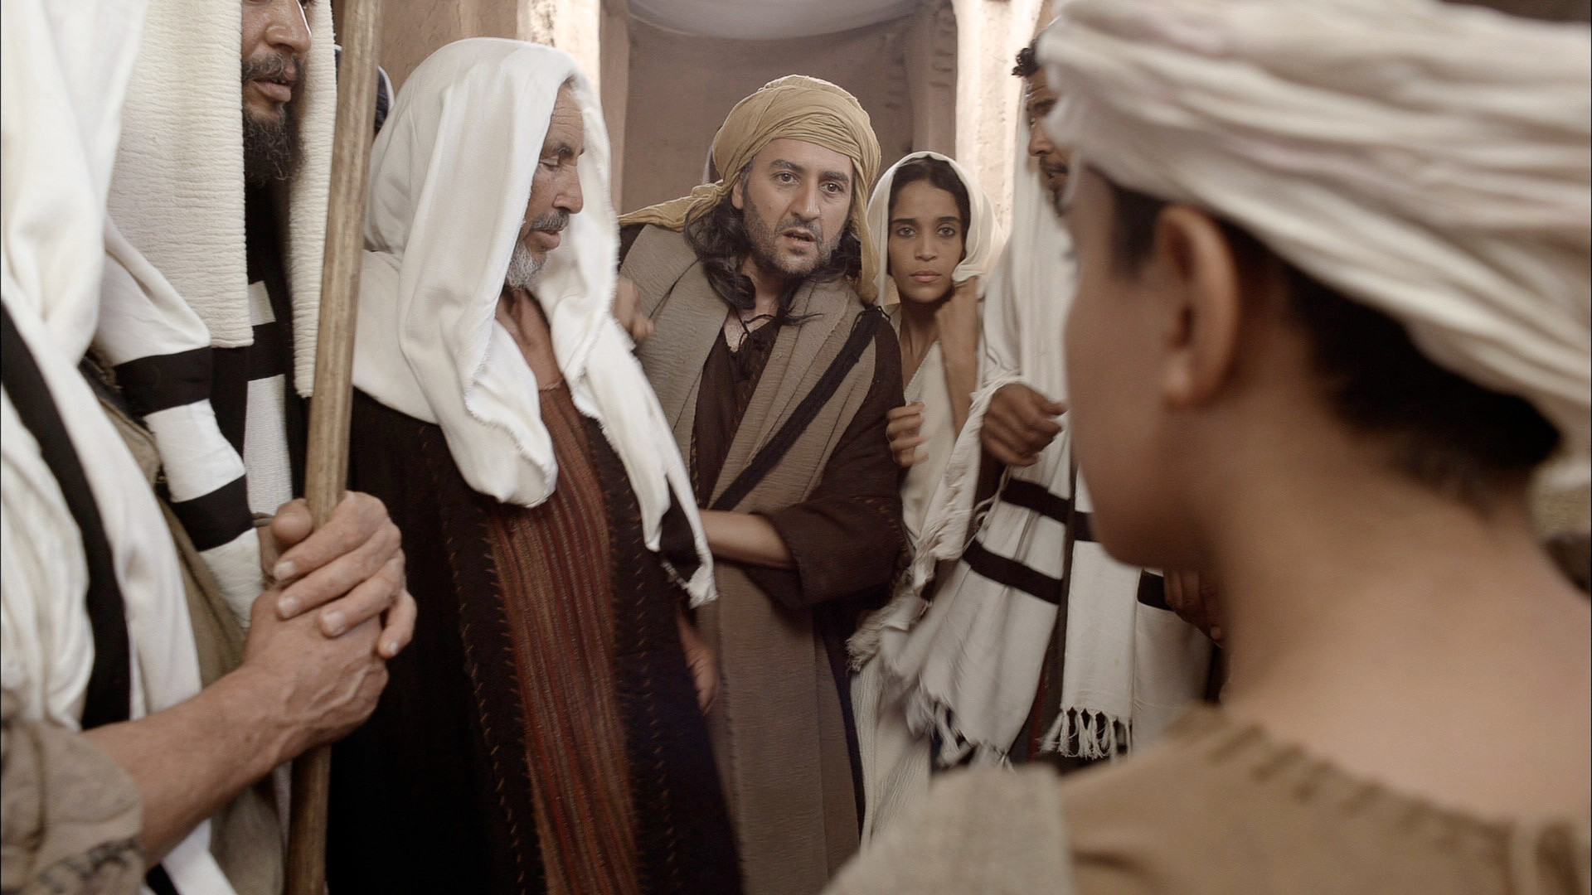
Notes:
... they saw Jesus sitting with the teachers of God’s law.

Slide 12
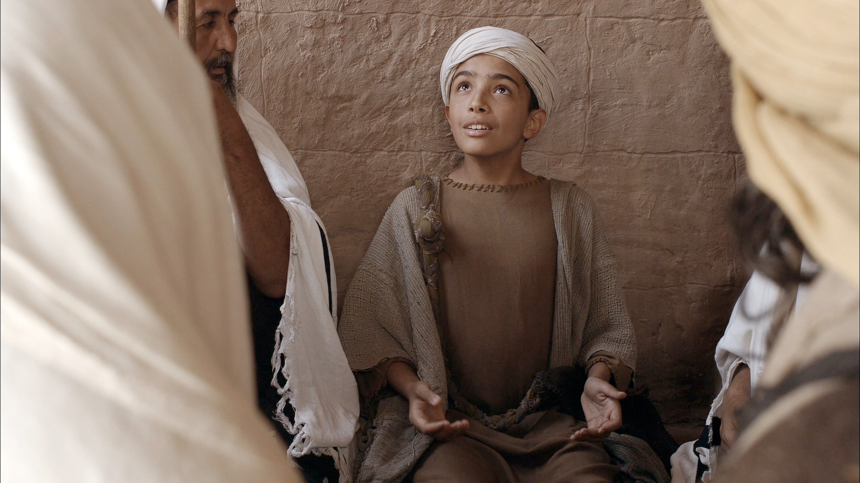
Notes:
Those listening to Jesus were amazed at the questions He asked and the answers He gave.

Slide 13
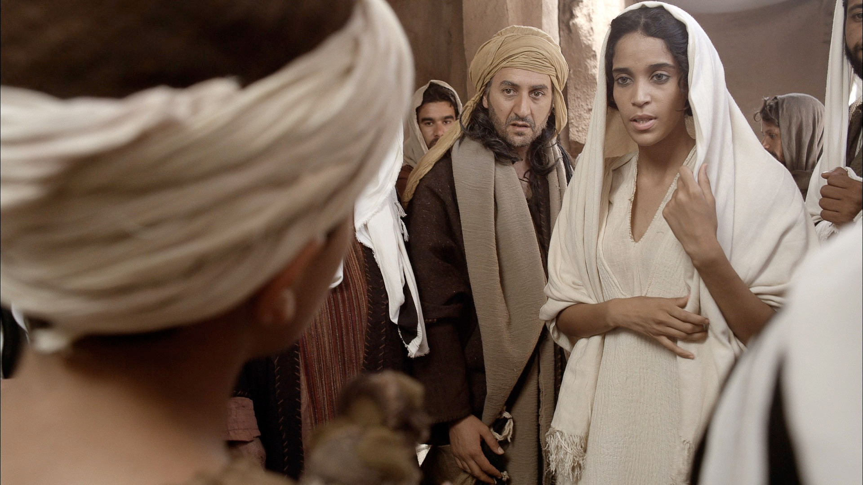
Notes:
‘Son, why have you treated us like this?’ asked Mary. ‘Joseph and I have been anxiously searching for you.’

Slide 14
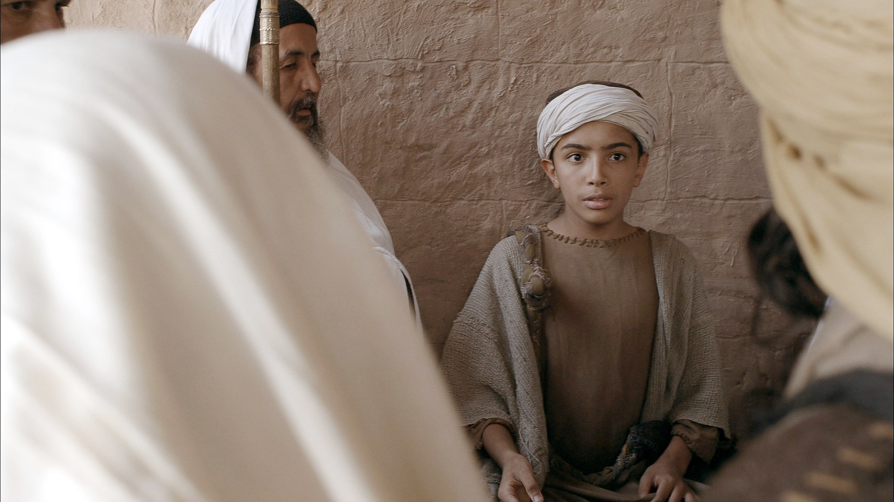
Notes:
‘Why were you searching for me?’ Jesus asked. ‘Didn’t you know I had to be in my Father’s house doing what He wants me to do?’

Slide 15
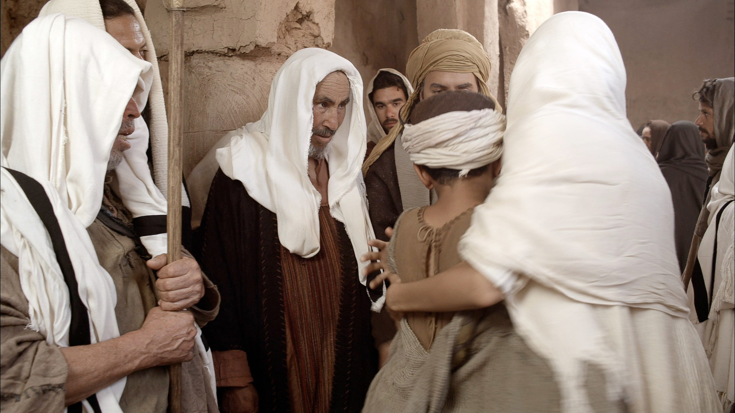
Notes:
Mary and Joseph did not understand what He was saying to them.

Slide 16
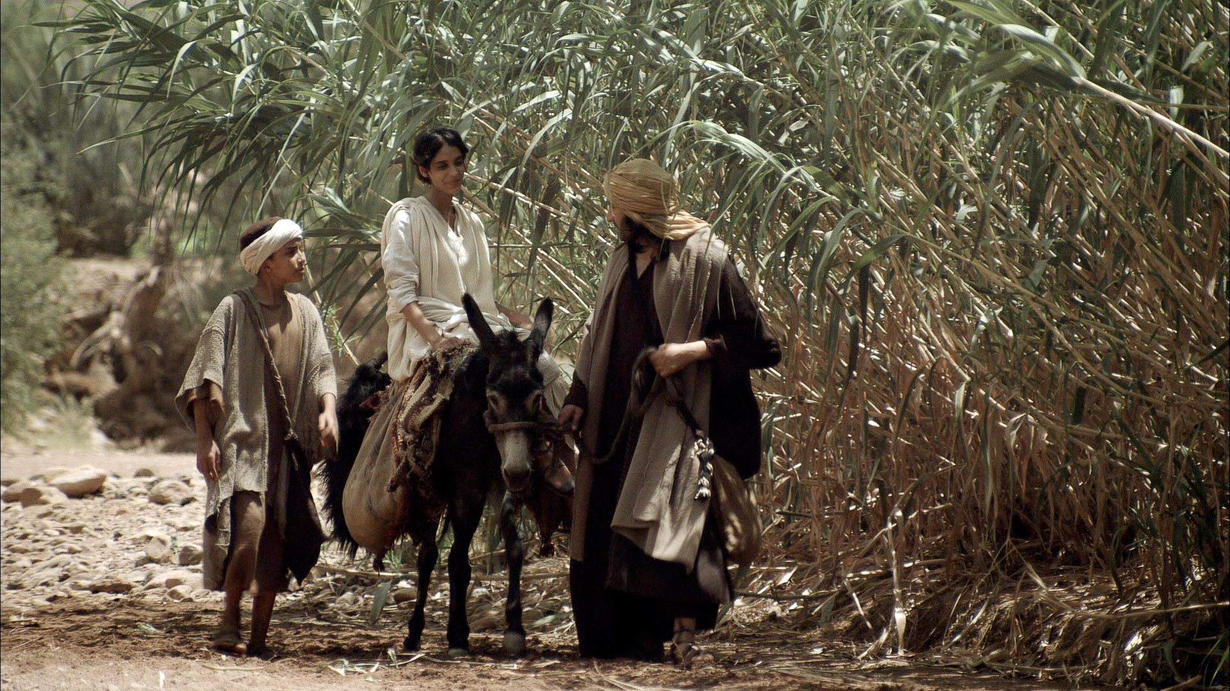
Notes:
Jesus returned to Nazareth with His parents and was obedient to them. Mary treasured all these things in her heart. And Jesus grew in wisdom and stature, and in favour with God and man.

Slide 17


